Slide 1


Slide 2

Case Stud : Mark IV Coffee Maker
Target System Hardware Specification:
The Mark IV Special must reliably control boiler heaters, warmer plates, valve mechanics, and button arrays based on safety constraints and physical conditions:
Safety First: If the pot is removed during boiling, the water flow must be stopped immediately.
Energy Preservation: The warmer plate turns ON only if coffee is physically present in the pot.
Hardware Limits: Control boiling elements, valves, and handle button polling without multithreading.

Slide 3




Anal Zin
•
Naive Anti-Patterns
Hyper-Concrete Modeling
Mapping physical components (Boiler, WarmerPlate, Light, Button) directly into individual structural classes.
The Rise of ··vapor Classes''
Lacking independent states or localized logic, classes like 'Light' and 'Button' act as raw call-translators.
Fatal Flaw: Missing Behavior
This models "nouns" instead of the active "behavior" of the program. Programs are driven by execution and information flows, not static physical replication.
Fatal Flaw: Zero Autonomy
They delegate straight to raw hardware APls. They are useless wrappers that could be removed entirely with no loss of system integrity or change in domain logic.

Slide 4



The Three Architectural Sins
God Classes
When surrounding classes are "vapor", the entire operational logic collapsing back into a single central coordinator.
Imaginary Abstractions
Developing base interfaces (e.g., Heater, Sensor) that are entirely unused by other components, or contain ambiguous contracts.
Over-Defensive Code
Flooding the system with redundant tests and validation loops at both client and server call boundaries.
Result: Highly procedural procedural code written in a pseudo-GO language environment.
Result: Massive code bloat that masks critical architectural design flaws.
Result: Over-engineering that complicates the hierarchy without adding structural behavior.

Slide 5



Re-architectin : The Core Abstractions
HotWaterSource
Conceptual Boundary: Encapsulates water boiling and delivery behavior.
ContainmentVessel
Conceptual Boundary: Encapsulates warm-keeping and coffee containment behavior.
In the Mark IV, the physical boiler sensor, valve mechanism, and heating coils are unified behind this logical interface. It is responsible for heating, pausing, and resuming boiling cycles cleanly.
In the Mark IV, this wraps the warmer plate and sensor. It checks safety states, decides if coffee is ready or empty, and signals the HotWaterSource when to halt extraction.

Slide 6





lnvert1•n
Software Associations are NOT Physical Flows
A common beginner mistake (called "Crossed Wires") is drawing dependency directions from the Water Source to the Vessel, because physical coffee flows downward.
The Rule: Associations map control messages, not physical liquids.
INVERSION OF CONTROL
The ContainmentVessel must query if the system is ready and send pause/resume triggers back to the HotWaterSource. Therefore, the dependency must logically point upstream.

Slide 7



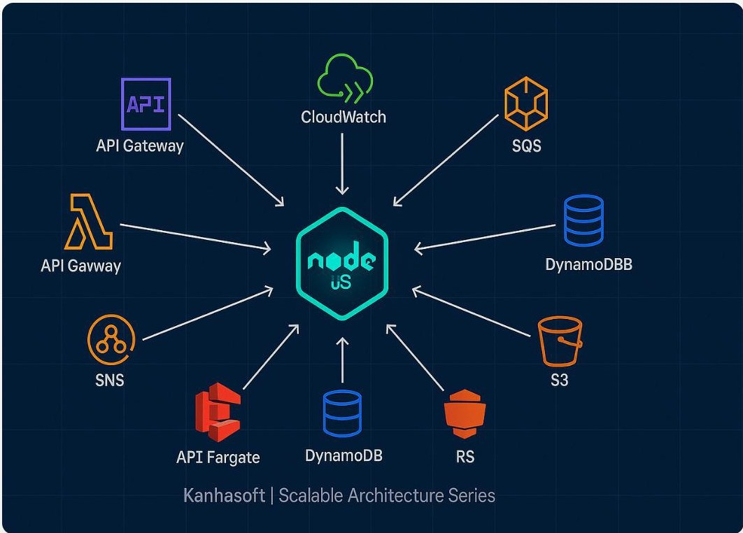
The De
endenc
Inversi•on Pr1• nc1•
DIP
Isolate High-Level Policies from Details
The core abstract triad (Userlnterface, HotWaterSource, ContainmentVessel) constitutes the high-level policy of the coffee maker. Under the DIP, this policy must never know about specific hardware details.
Pure Abstract Rules: Decisions like "Only start brewing if water is present and pot is empty" live in the parent classes.
Concrete Derivatives: Physical api commands are isolated inside specific boundary components (M4Userlnterface, M4HotWaterSource, etc.).

Slide 8
Sin le-Threaded Pollin
Framework
Because small embedded microcontrollers lack multithreading support, the execution loops must process asynchronous signals without blocking:
✓ t1 The Pollable Interface: Defines a clean contract requiring concrete derivatives to implement a lightweight pol 1()
method.
✓ oo Centralized Main Loop: An infinite execution loop inside the system entry point constantly executes poll commands on each component, catching hardware state transitions in real time.
✓ C Asynchronous Decoupling: Isolating how data is retrieved (polling vs threading) ensures that changing the hardware interface later requires zero modifications to our high-level policies.

Slide 9

Architectural Pra
matism vs. Overkill
Procedural FSM State
Machine
Polymorphic Decoupled
00D
The "OOverkill" Phenomenon
In tiny, low-resource systems, 00D boilerplate might be overkill. However, as business variance scale (e.g., modifying the drip machine into an automated soup maker), dependency decoupling completely pays for itself.

Slide 10

Case Stud
2: Towers of Hanoi 00D
Refining the classical Towers of Hanoi into a decentralized model of interacting objects:
Ring l as ''The Pacer··
Instead of a global orchestrator calculating math arrays, the smallest Ring (Size 1) acts as an active pacing object executing moves on every alternate turn.
Decentralized Logic
Rings know their immutable size and movement direction. Poles act as validating stacks that defensively check ring stacking legality.
0
Circular Linked Poles
Connecting Pole instances together in a spatial circular ring structure (Pole 1 f""7 Pole 2 f""7 Pole 3), allowing automatic neighbor resolution.
0
0

Slide 11

Desi•
Contract DbC
Contract Component
Responsibilities
Violations Indicator
Pre-conditions
Obligations placed on the Client (caller) to ensure correct state before routine execution.
Indicates a critical bug inside the calling client module.
Obligations placed on the Supplier (routine) to ensure clean output state after successful execution.
Indicates a critical bug inside the supplier method implementation.
Post-conditions
State integrity assertions that must persist across all externally observable transition
states.
Indicates corruption of system state; requires fail-fast exception rescue actions.
Class Invariants

Slide 12


